Slide 1
Pizza Store Sales
Analysis
Pizza Sales Case Study using Tableau
By,
Chaithra V

Slide 2
INTRODUCTION
Welcome to the Pizza Sales Analysis case study. In this project, I act as a junior data analyst analyzing pizza sales data to uncover trends, customer behavior, and business opportunities. The analysis follows the data analysis process: Ask, Prepare, Process, Analyze, Share, and Act, and uses Tableau for data visualization.

Slide 3
Scenario
A pizza business wants to better understand its sales performance, customer ordering patterns, and product popularity. The goal is to use data-driven insights to improve revenue, optimize the menu, and support business decision-making.

Slide 4
Recommended Analysis
How many customers do we have each day?Are there any peak days or peak hours when customer demand is highest?
How many pizzas are typically included in an order? Are there any best-selling or most frequently ordered pizzas?
How much revenue did the business generate this year? Can we identify monthly trends or seasonality in sales?
Are there any pizzas that underperform and should be removed from the menu? Are there promotional opportunities we can leverage to increase sales during low-demand periods?

Slide 5
01
How many customers do we have each day?Are there any peak days or peak hours when customer demand is highest?

Slide 6
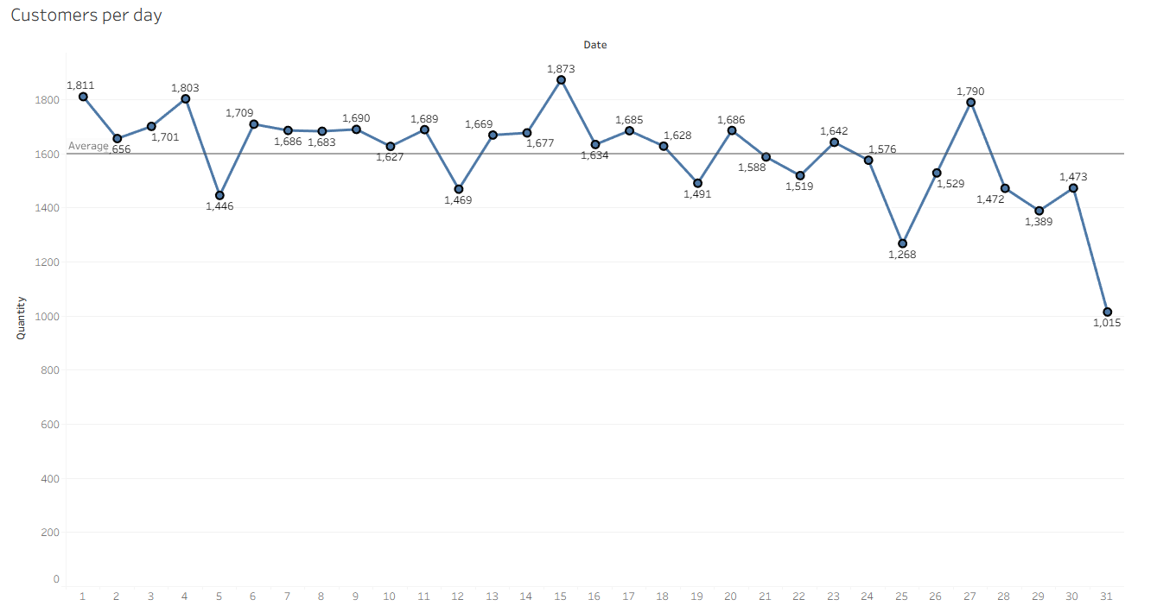
Customers per day
The dataset does not contain unique customer details. Therefore, the following assumptions were made:
Count of order_id ≈ number of customers
Assumption: One customer orders one pizza
Based on this assumption, the average number of customers per day is 1,599.

Slide 7
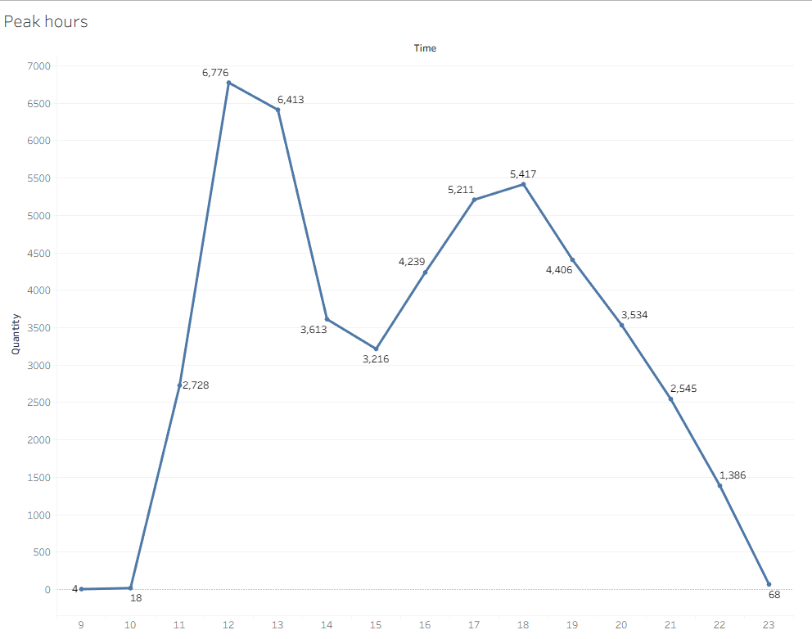
Peak Hours
To identify peak hours:
Hour (order time) was used as columns
Sum of quantity was used as rows
The analysis shows that 12:00 PM (noon) is the peak ordering hour

Slide 8
02
How many pizzas are typically included in an order? Are there any best-selling or most frequently ordered pizzas?

Slide 9
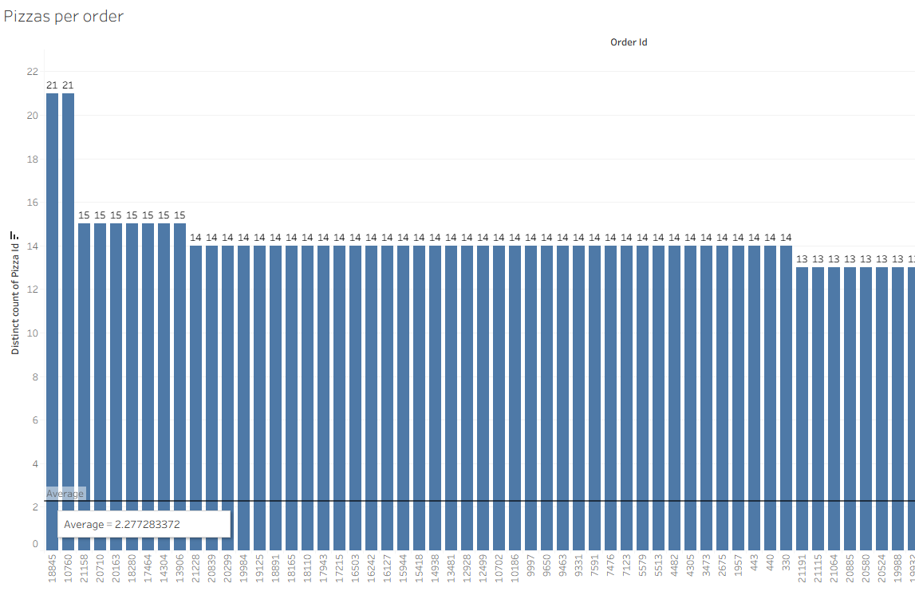
Pizza per order
Pizzas per Order
order_id was used as columns
pizza_id was used as rows
The analysis shows that 2 pizzas are typically included in each order.

Slide 10
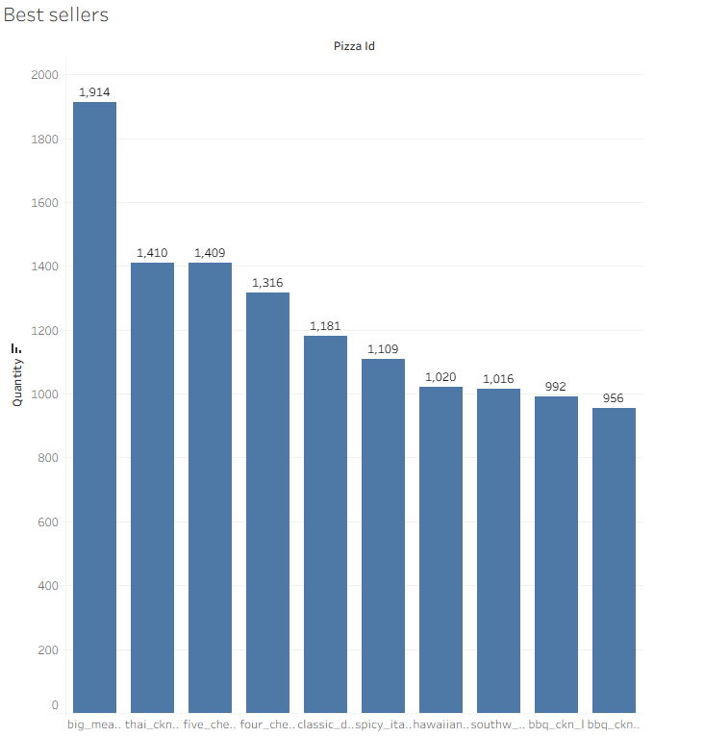
Best seller
Best Seller
pizza_id was used as columns
quantity sold was used as rows
The best-selling pizza is Big Meats, with 1,914 pizzas sold.

Slide 11
03
How much revenue did the business generate this year? Can we identify monthly trends or seasonality in sales?

Slide 12
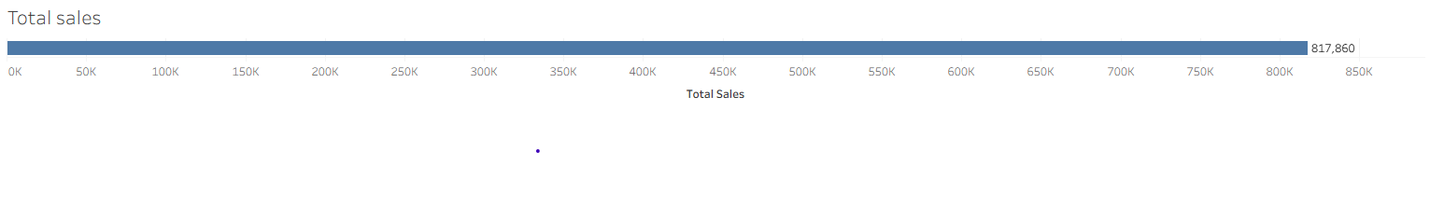
Total sales
Total Sales
Since total sales were not directly available, a calculated field was created:
Total Sales = Quantity × Price
Using this calculation, the total annual revenue is ₹817,860.

Slide 13
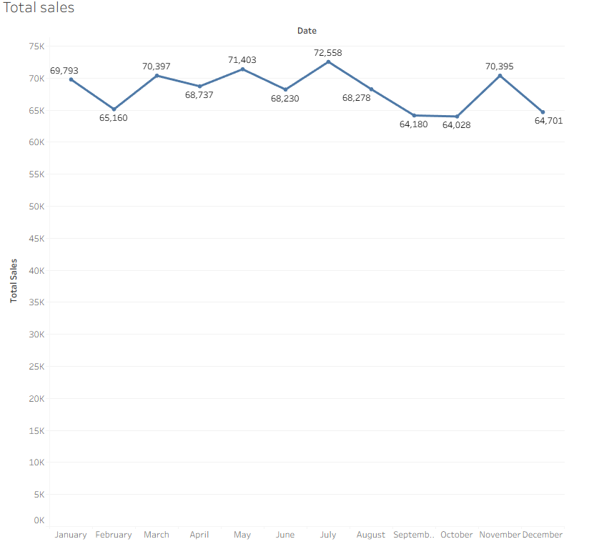
Total sales (month)
Seasonality
Month (order date) was used as columns
Total sales was used as rows
The analysis shows clear seasonality, with certain months generating higher sales than others.

Slide 14
04
Are there any pizzas that underperform and should be removed from the menu? Are there promotional opportunities we can leverage to increase sales during low-demand periods?

Slide 15
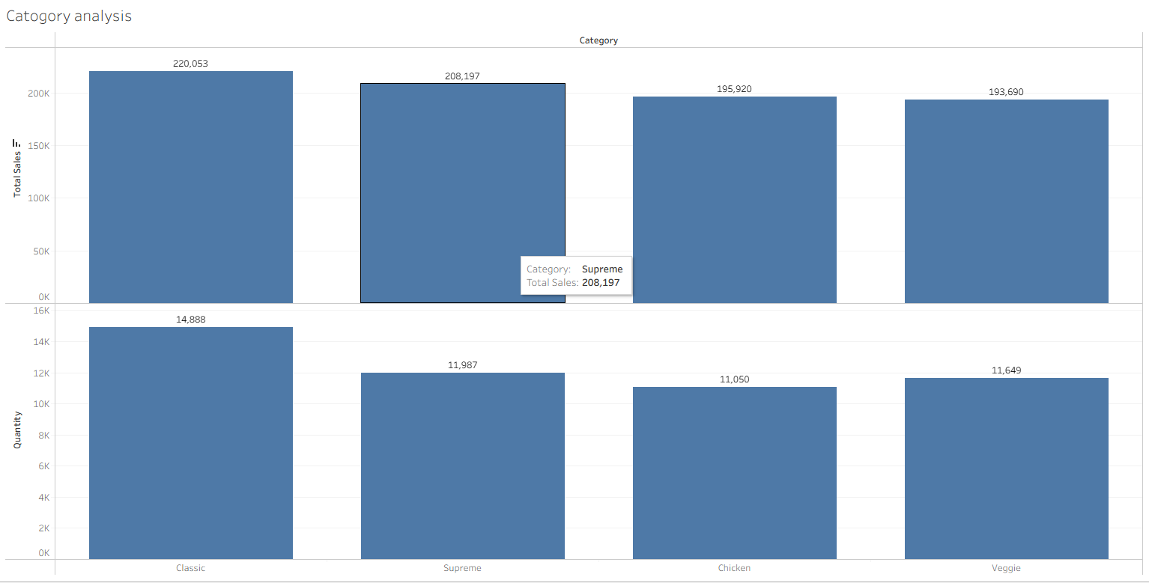
Category based analysis

Slide 16
Category based analysis
Category-Based Analysis
Chicken and Veggie categories generate the lowest revenue
Veggie pizzas sell in higher quantity but have lower pricing
Recommendation:
Introduce promotions or combo offers on Chicken pizzas to increase sales volume.

Slide 17
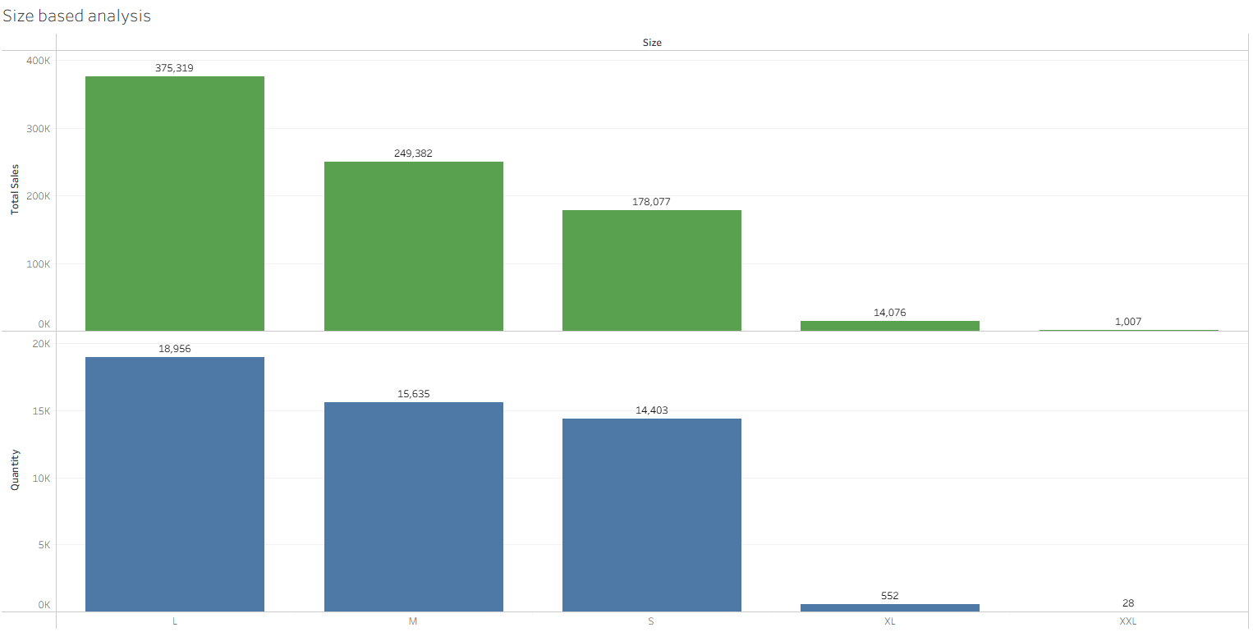
Size based analysis

Slide 18
Size based analysis
Size-Based Analysis
XL and XXL pizzas generate low revenue and low quantity sales
Recommendations:
Offer discounts or promotions on XL pizzas
Consider removing XXL pizzas from the menu if sales do not improve

Slide 19
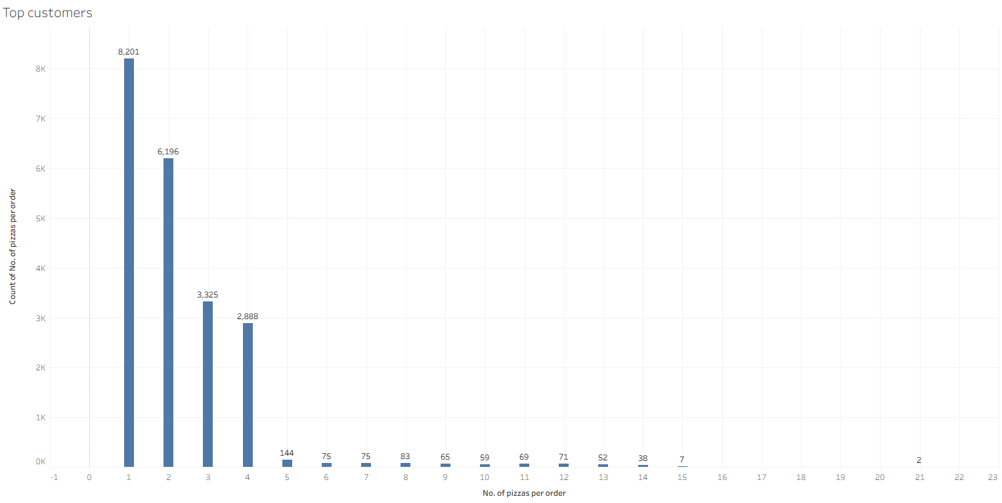
Top customers

Slide 20
Top customer Analysis
Most customers order fewer than 4 pizzas per order.
Only a small number of customers order more than 5 pizzas, but these orders generate higher revenue.
Recommendation:
Offer special discounts or deals for customers ordering more than 5 pizzas to encourage higher-value purchases.

Slide 21
Final Recommendation
Promote best-selling pizzas during peak hours
Introduce targeted offers for Chicken and XL-sized pizzas
Use bulk-order discounts to increase average order value
Optimize or remove consistently underperforming menu items

Slide 22
Summary
This pizza sales analysis used one year of transaction data to understand customer behavior, sales trends, and product performance. The analysis identified peak ordering hours, best-selling pizzas, seasonal revenue patterns, and underperforming categories. Based on these insights, targeted promotions, menu optimization, and time-based offers are recommended to improve overall sales and revenue.

Slide 23
THANKS

